Slide 1
Fight For your Rights non-violEnt protEst
DEMOCRACY= FREEDOM FOR EVERYONE

Slide 2
Danilo dolci and non-violent protest

Slide 3
What can we do if we are unhappy with government decisions?
How can we change what we don’t like?

Slide 4
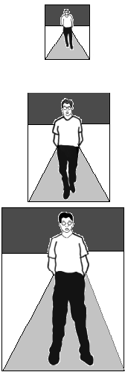
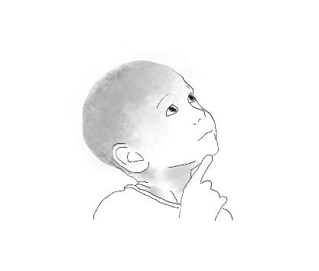
Can we change the world?
Yes we can!
Where do we start from?

Slide 5
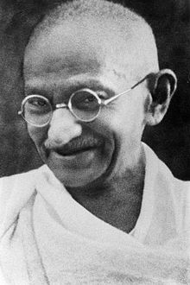
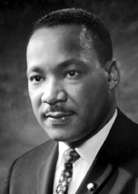
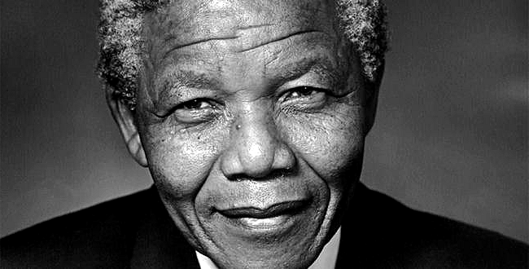
WHO CHANGED THE WORLD? MEN…
«If you can’t fly,then run,
If you can’t run,then walk,
If you can’t walk,then crawl.
But whatever you do,
You have to keep moving forward.»
MARTIN LUTHER KING
«Be the change that you wish to see in the world»
GHANDI
«Do not judge me by my successes, judge me by how many times I feel down and got back up again»
NELSON MANDELA

Slide 6
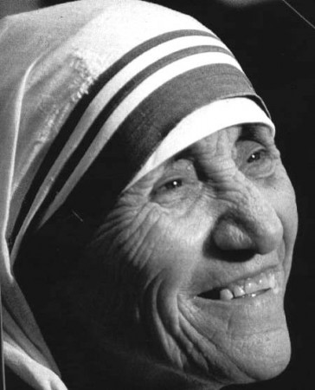
…WOMEN
«You must never be fearful about what you are doing when it is right»
ROSA PARKS
«Do not wait for leaders; do it alone, person to person.»
MOTHER TERESA OF CALCUTTA

Slide 7
What do they have in common?
They fought against injustice by peaceful protest :
Picketing: form of protest in which people (called picketers) gather outside a place of work or location where an event is taking place.
Protest march: type of protest that generally involves a group of people walking from an assembly point to a predetermined destination, usually culminating in a political rally, and often evoking a military march or parade.
Hunger strike: method of pressure in which participants fast as an act of political protest, or to provoke feelings of guilt in others, usually with the objective to achieve a specific goal, such as a policy change.

Slide 8
Group or mass petitions: written requests or supplications seeking the redress of a specific grievance, signed by a large or small number of individuals acting on behalf of organizations, institutions or constituencies.
Public speaking: process or act of performing a speech to a live audience. This type of speech has three main aims: to inform, to persuade and to entertain.

Slide 9
There is also Danilo Dolci: do you know him?

Slide 10
Who was Danilo Dolci?
Danilo Dolci was an Italian social activist,sociologist, popular educator and poet
He was called «The Gandhi of Sicily»
When Danilo Dolci came to Sicily in the 50’s he found out some problems such as: mafia, poverty, drought , undernourishment and illiteracy.
About twenty years ago our teachers chose to devote our school to him

Slide 11
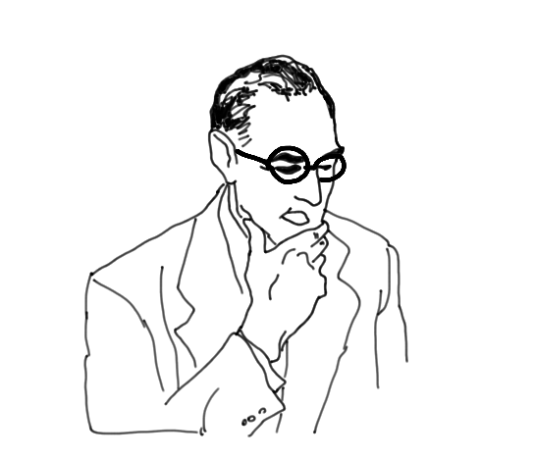
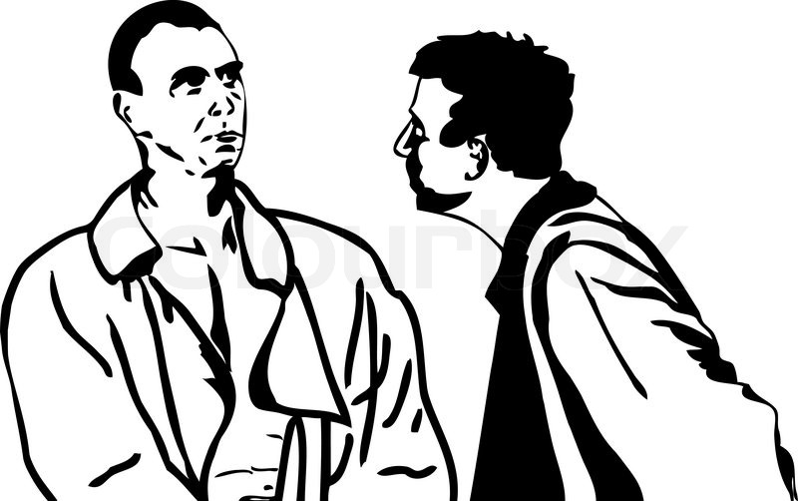
A container? Why not a dam?
We would need a basin, a container..

Slide 12
What did Danilo Dolci do?
Dolci helped poor and illiterate people to become aware of their rights. He encouraged poor and unemployed people to collaborate and to create agricultural cooperatives
He strongly denounced the Sicilian Government's hypocrisy and corruption
Despite Mafia's intimidation, that wanted to control water resources, he managed to build a very useful dam to supply water to one of the poorest parts of Sicily (S. Giuseppe Jato)
He experimented a new kind of education based on listening and creativity

Slide 13
Strike on backwards(Danilo Dolci’s new form of protest)
On the 2th February 1956 Danilo Dolci was arrested while leading a group of labourers working in an abandoned road nearby Partinico. Dolci explained to the police that according to the Article 4 of the Italian Constitution labour wasn’t just a right, but a duty.
Dolci was charged with occupation of public land and obstruction to a public official, and he and his friends weren’t given provisional release.

Slide 14
Why was Danilo Dolci called "the Gandhi of Sicily"?
He is associated with the figure of Gandhi because Dolci used hunger strikes, sit-down protests and non-violent demonstrations as methods to force the regional and national government to make improvements in the poverty stricken areas of the island. For these reasons he became known as the “Gandhi of Sicily“ as a French journalist had dubbed him.

Slide 15
His death
Dolci died on December 30, 1997 in Trappeto, from heart failure.
The obituary about him published by “The Independent” reported that he was a man who in his youth studied architecture, but then he became an architect of the social change.

